Slide 1

Understanding Deal Seekers
And meeting their needs
Kelly Peterson
Date: Sept 2024

Slide 2
Background
We know that pricing, affordability and availability of deals and promotions are one of the biggest concerns for DoorDash Cx and a huge driver of order conversion. This research aims to understand the different personas of Cx that are “deal seekers” on DoorDash to better provide features, tooling and personalization to their unique needs.
Research Questions
How many “personas” of Deal Seekers exist and who are they?
What are the promotion preferences for different deal seeker personas?
What priorities outside of deals exist for different deal seeking personas?
Research Approach
We conducted this research in two-phases:
We conducted a 15 min survey among N=300 Cx focused on understanding the role that promos play in the decision making, their priorities when ordering and the factors that are most important to them when comparing deals to one another.
20 min 1:1 interviews with 3-4 Cx of each persona to understand more detail around their decision making, promo preferences and navigation pathways on DoorDash.

Slide 3
Building Personas

Slide 4

Analysis Approach (1 of 2)
We utilized 10 variables from online survey to run a k-means cluster analysis. The variables included:
Frequency of ordering on DoorDash
Frequency of using promos/discounts on DoorDash
Attitudes around budgeting on DoorDash
Attitudes around promos/discounts on DoorDash
Promotion preferences/avg expected spend

Slide 5




Analysis Approach (2 of 2)
Clusters/personas are evaluated for:
Size: Is it viable?
Number: Is it detailed enough, but manageable?
From the analysis output, we use a mix of art and science to select the appropriate set of clusters/personas.
Target: Is it understandable and actionable?

Slide 6
This led to the identification of 3 key personas of deal seekers…
Promo usage by cost sensitivity:
High cost sensitivity
22%
Budget Minders
0% of orders on average use promos
100% of orders on average use promos
47%
Deal Hunters
31%
Thrill Seekers
Low cost sensitivity

Slide 7



…with unique experiences and preferences
Deal Hunters
I want to make sure I’m getting the best possible deal on every order I place.
Budget Minders
I need quality food within my cost range, a promo is helpful but not the only way to save
Thrill Seekers
I am going to order what I want regardless of promotions, but it is exciting when I get a good deal

Slide 8
Meet the Personas

Slide 9

Who are Deal Hunters? (47%)
Who are they?
What are their thoughts on budgeting/spending?
Least likely of any persona to have a strict budget, though most Cx have a range they like to stay within
54% T2B agree that they will not place on order on any app unless there is a promo or discount
28% want to make sure they are spending the least amount across potential ordering experiences (vs 15% Total)
They do not feel it is fair to spend more than $25 for a promo and expect at least $10 in value from promos
Deal Hunters tend to be younger, educated individuals living in metropolitan areas or cities
What are their ordering behaviors?
What are their promotion preferences?
More likely to order monthly or a few times a month
More than half use promos on every order and compare across apps
63% of DoorDash orders on average use a promotion(stated)
Prefer to see % off order, or $ off order deals without minimum spend requirements
Also strong interest in BOGO compared to other personas

Slide 10
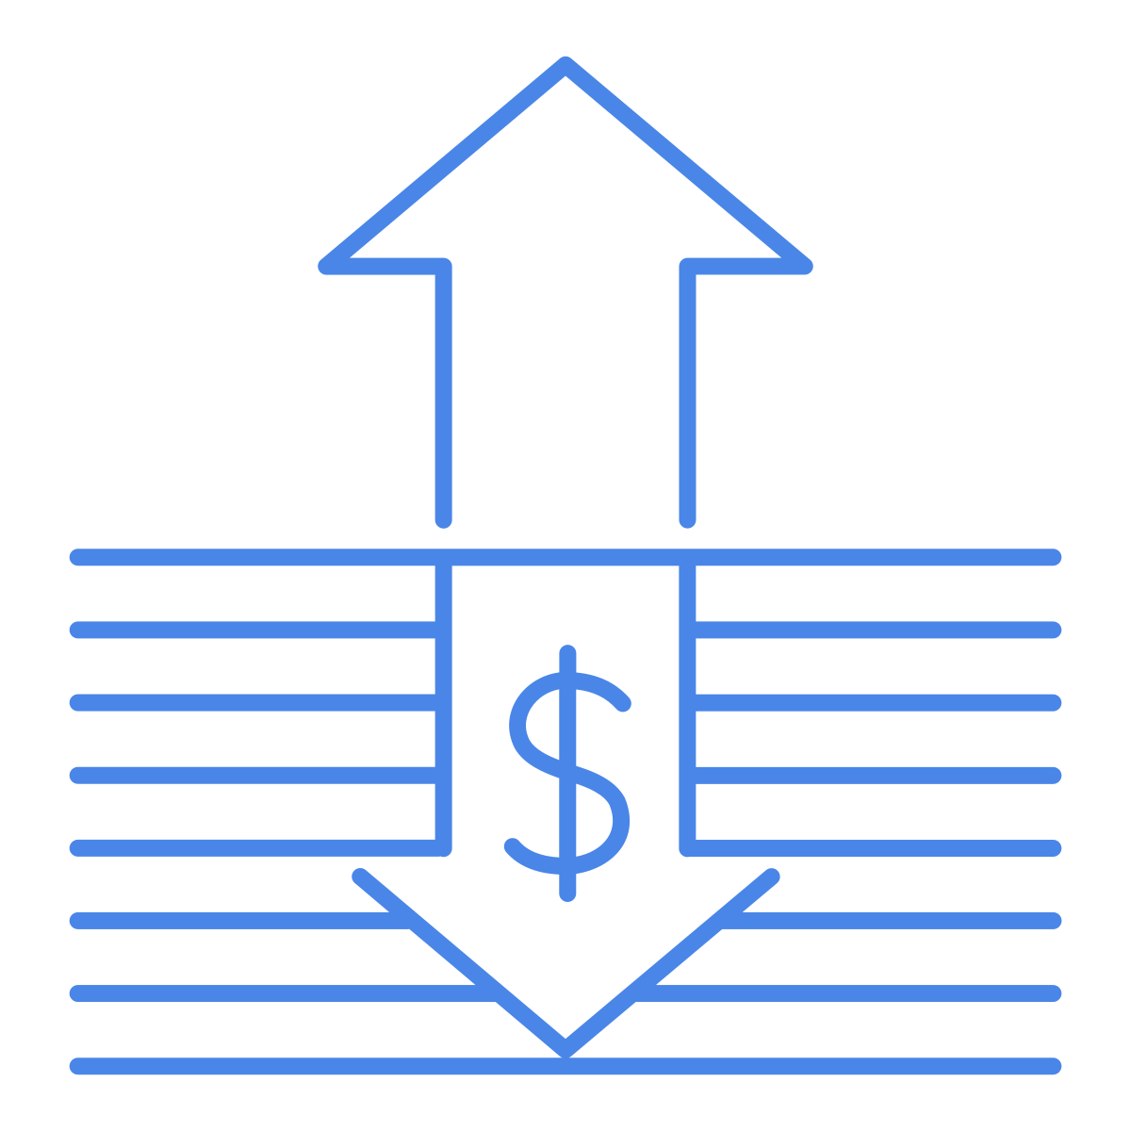
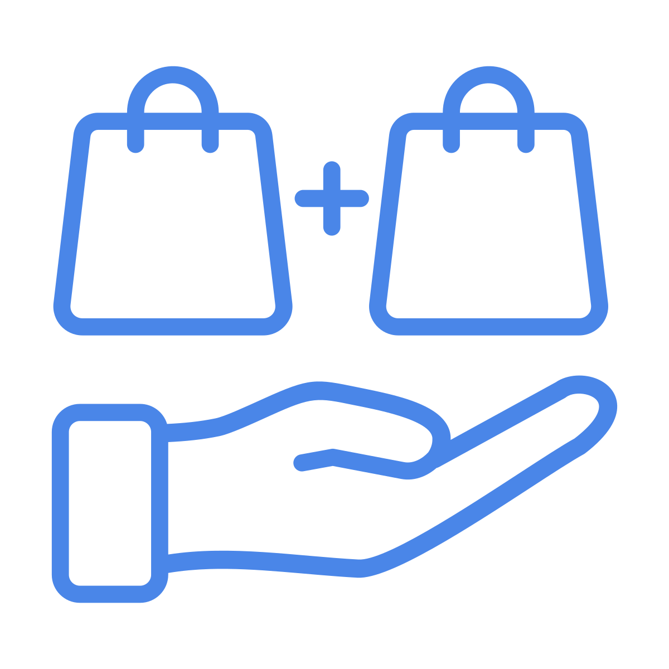

How can we reach Deal Hunters?
Deal Hunters require further discussion to understand how much we want to encourage and reward these behaviors. This is a very large segment so additional behavioral analysis may be needed to identify which Cx are truly loss leaders
Deal Hunters gravitate towards deals with low or no minimum spend and bogo. Prioritize BOGO for these Cx as it is the greatest opportunity for both Cx and Mx satisfaction. They are also most likely to be in single individual HH where the concerns around ordering “the exact same thing” are reduced.
Deal Hunters are likely to compare across multiple apps, including UE. Education on the location, value and use of the deal hub will be important for this segment as they will know how to quickly identify all deals available on UE.

Slide 11
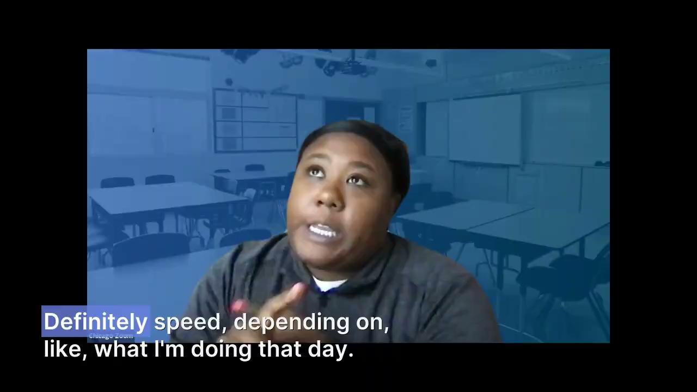
Let’s hear from a Deal Hunter…

Slide 12

Who are Budget Minders (22%)?
Who are they?
What are their thoughts on budgeting/spending?
They do not necessarily have a strict budget in mind but instead have a range of comfort
They are focused on keeping spend under a threshold that they feel comfortable with (45% T2B agree).
They care more about food prices, speed and quality then they do about finding a promotion or discount
Budget minders tend to be in their late 30s-40s with children in the HH. They live in a mix of city and suburban areas. They skew towards single parents.
What are their ordering behaviors?
What are their promotion preferences?
They tend to order frequently, typically weekly are more often
They look for deals/and discounts every few orders and will also compare to other apps every few orders
They tend to look for value in meals around portion size or combo/family meals
Are most interested in getting $ off their order or a free item. Prefer to see clear value.
Not swayed by BOGO or % off order unlike other personas

Slide 13

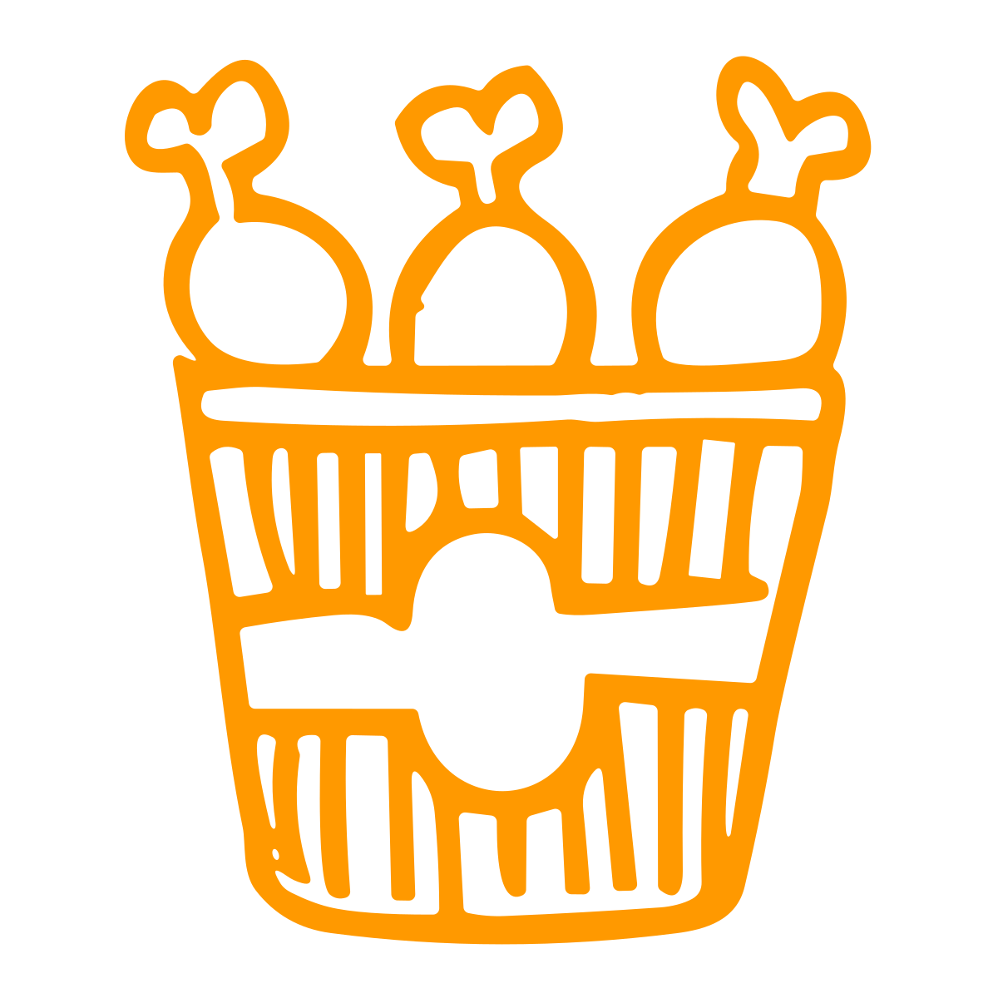

How can we reach Budget Minders?
Budget Minders are strict about a cost range they want to stay within, and focus more on quality and experience than getting a deal it’s self. They may be best served by more consistent saving opportunities such as affordable meals or happy hour.
Additionally, Budget Minders are likely to have kids in the HH. They often look for ways to save with quantity and combo meals. Providing them with opportunities to find family/combo meals within their deals experience may help better entice them to place an order or try a new Mx.
Budget Minders tend to think restaurant before deal and are therefore more likely to get their information from the USI vs. the deal hub. The team should explore the value of including affordability efforts in the USI for these Cx.

Slide 14
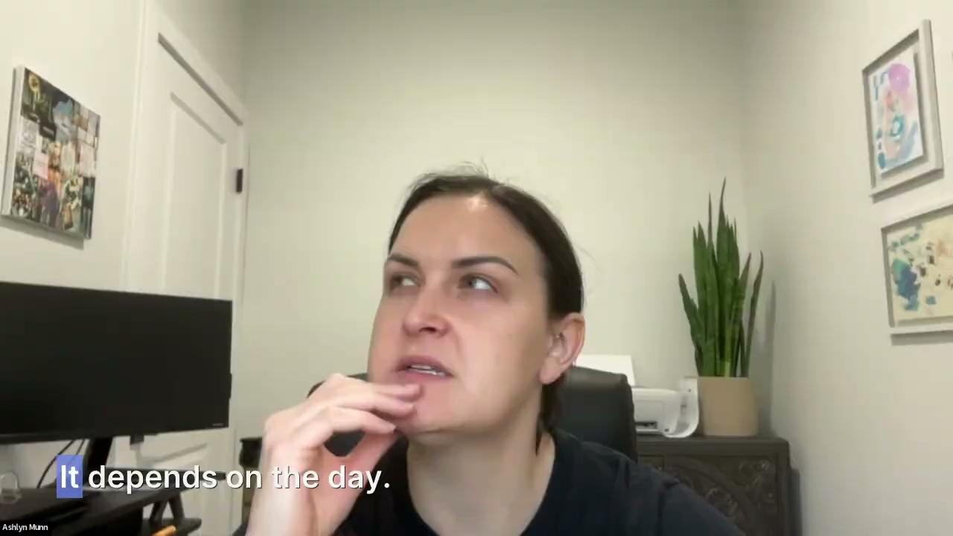
Let’s hear from a Budget Minder…

Slide 15

Who are Thrill Seekers (31%)?
Who are they?
What are their thoughts on budgeting/spending?
They are likely to have a set budget or range to stay within for their orders
Care more about the thrill of the deal then staying within a strict budget
79% T2B agree that they are not price sensitive, but just like the feeling of finding a good deal
Also place a high importance on food quality, speed and convenience
Tend to be educated and living in suburbs or towns. Skew older but also include a large portion of younger members
What are their ordering behaviors?
What are their promotion preferences?
Typically order weekly or several times per week
Look for deals frequently
Loyal to DoorDash- never/rarely compare deals across apps
Promo interests are similar to DHs with interest in % off an off, $ off an order, BOGO and free items

Slide 16


How can we reach Thrill Seekers?
Thrill Seekers are most likely to respond to experiences that require them to “earn” their rewards. Prioritize spend X get Y and loyalty promotions for this persona.
Thrill Seekers enjoy the hunt of the deal, introducing them to the deals hub may act a catalyst to increased browsing and new Mx exploration. They tend to prioritize quality and convenience over just the use of a promotion; tools helping them search for quality Rx are likely to be helpful.

Slide 17
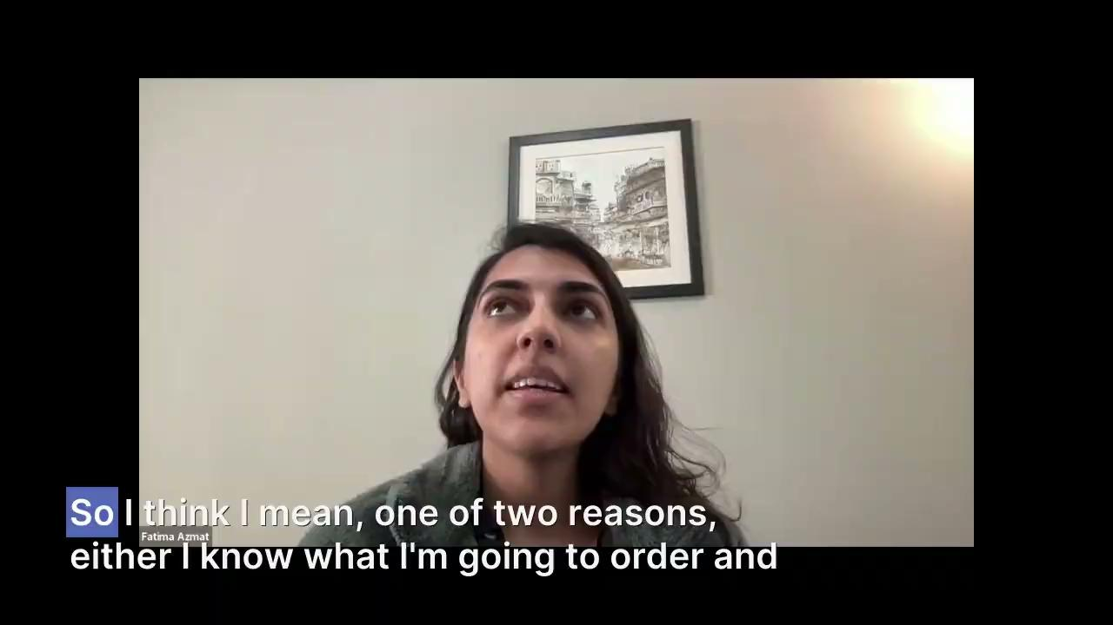
Let’s hear from a Thrill Seeker…

Slide 18
Persona cheat sheet:
Price sensitivity | Promo usage | Promo emotions | Frequency of order | # of ppl typical ordering for | Preferred promo type
Medium | Almost every order | Must-have | 1-2 times per month | 1 | No minimum & BOGO
High | Rarely | Functional | Weekly | 2+ | % off or Free item
Low | Every few orders | Exciting | Weekly or more often | 2+ | Free item, BOGO, loyalty
Deal Hunters
Budget Minders
Thrill Seekers

Slide 19
Detailed Insights

Slide 20
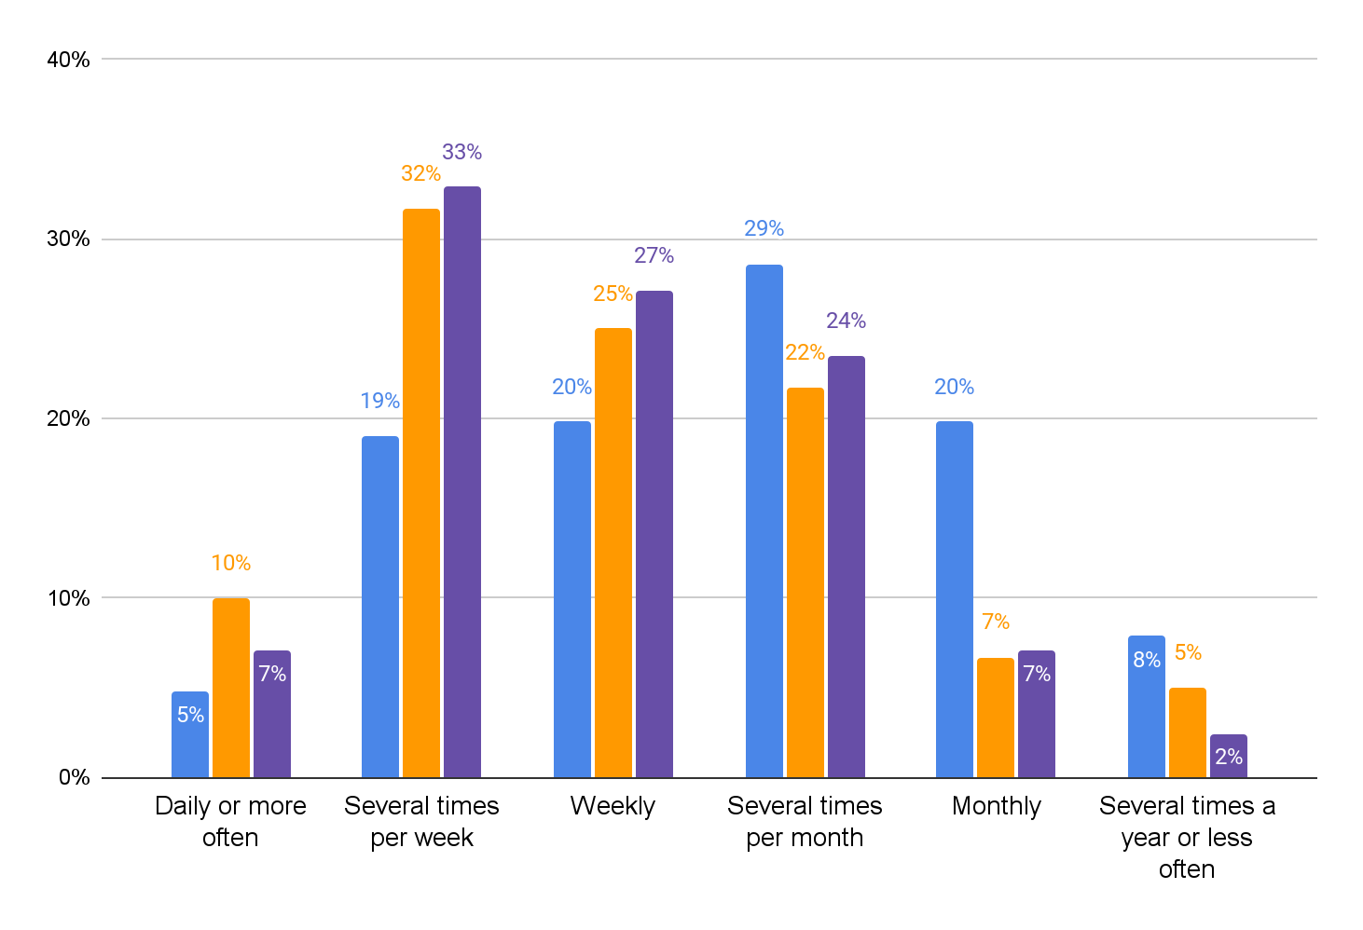
DHs tend order takeout the least frequent in addition to searching for promos and comparing promos across apps
How frequently do you order food delivery using third-party apps or websites?
How frequently do you look for promotions/discounts when ordering on DoorDash?
Deal Hunters
Budget Minders
Thrill Seekers
 | DH | BM | TS
Rarely | 6% | 22% | 17%
Every few orders | 22% | 48% | 28%
Every Order | 71% | 30% | 55%
How frequently do you compare deals on DoorDash to other third-party services when placing a takeout order?
 | DH | BM | TS
Never | 10% | 28% | 27%
Rarely | 20% | 23% | 27%
Every few orders | 24% | 33% | 28%
Every Order | 47% | 15% | 18%
Base: n= 126 Deal Hunters, n=60 Budget Minders, N=85 Thrill Seekers

Slide 21
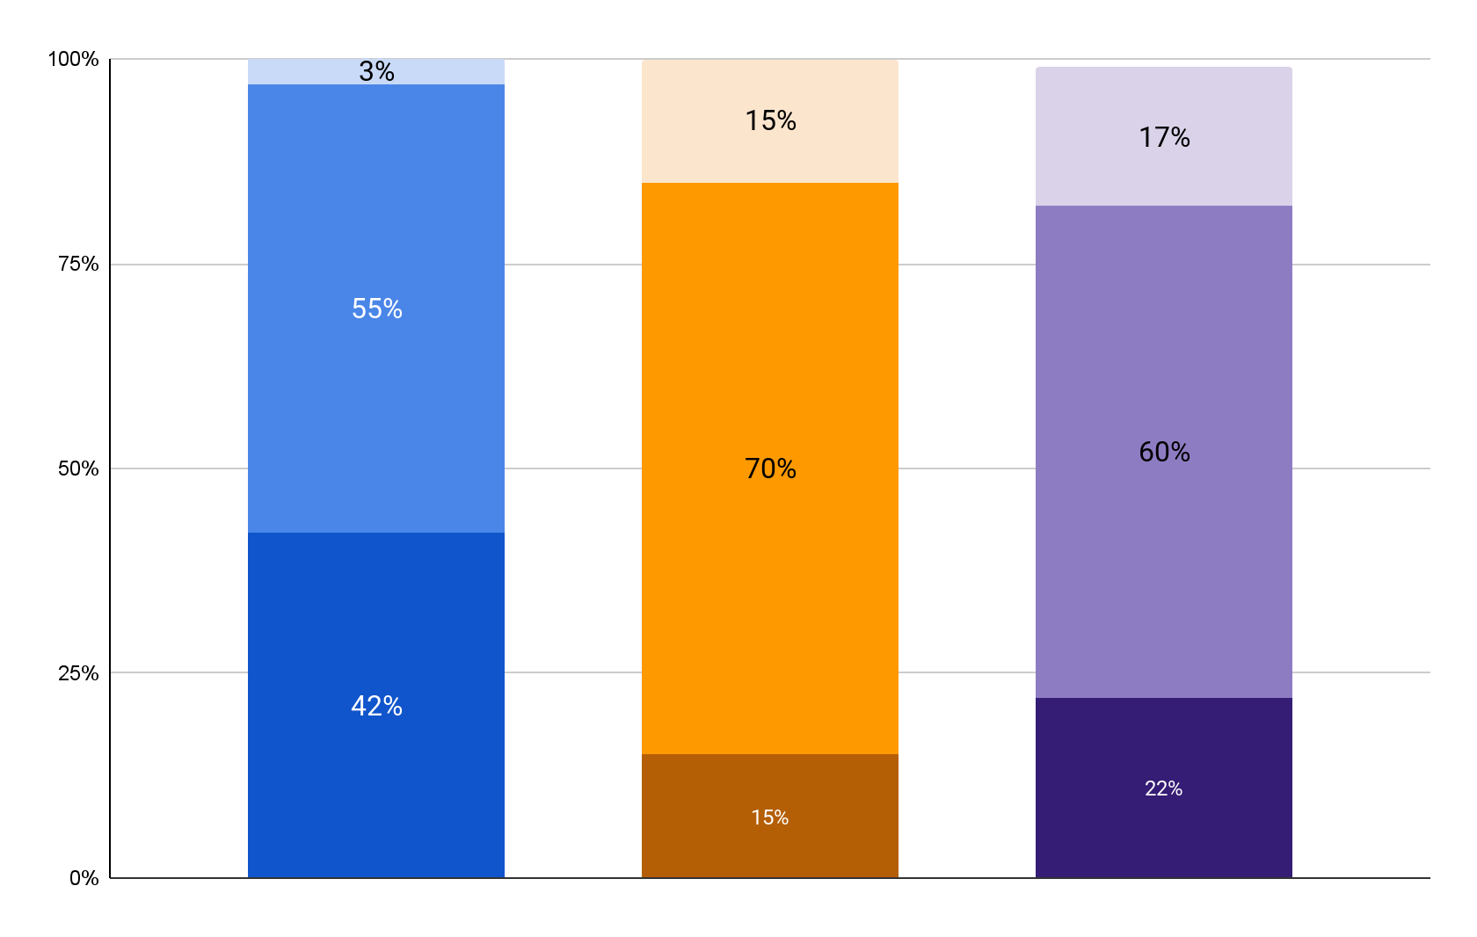
BM and TS tend to focus more on price range while DH over index on no budget
Budgeting on DoorDash
Strict budget
I have a set amount that I am willing to spend and will not go over
I have a range that I am willing to spend
I do not have a budget in mind when I order on DoorDash
No budget
Deal Hunters
Budget Minders
Thrill Seekers
Base: n= 126 Deal Hunters, n=60 Budget Minders, N=85 Thrill Seekers

Slide 22

BM are most focused on keeping under a budget threshold while TS and DH are more focused on the amount of savings
Financial goals when ordering (%T2B agree with statement)
Deal
Hunters
Budget Minders
Thrill
Seekers
Keeping my total spend under a threshold I feel comfortable with | 33% | 45% | 35%
Getting a good deal for my order | 40% | 43% | 46%
Making sure I am spending the least amount possible across ordering options | 28% | 12% | 19%
Base: n= 126 Deal Hunters, n=60 Budget Minders, N=85 Thrill Seekers

Slide 23
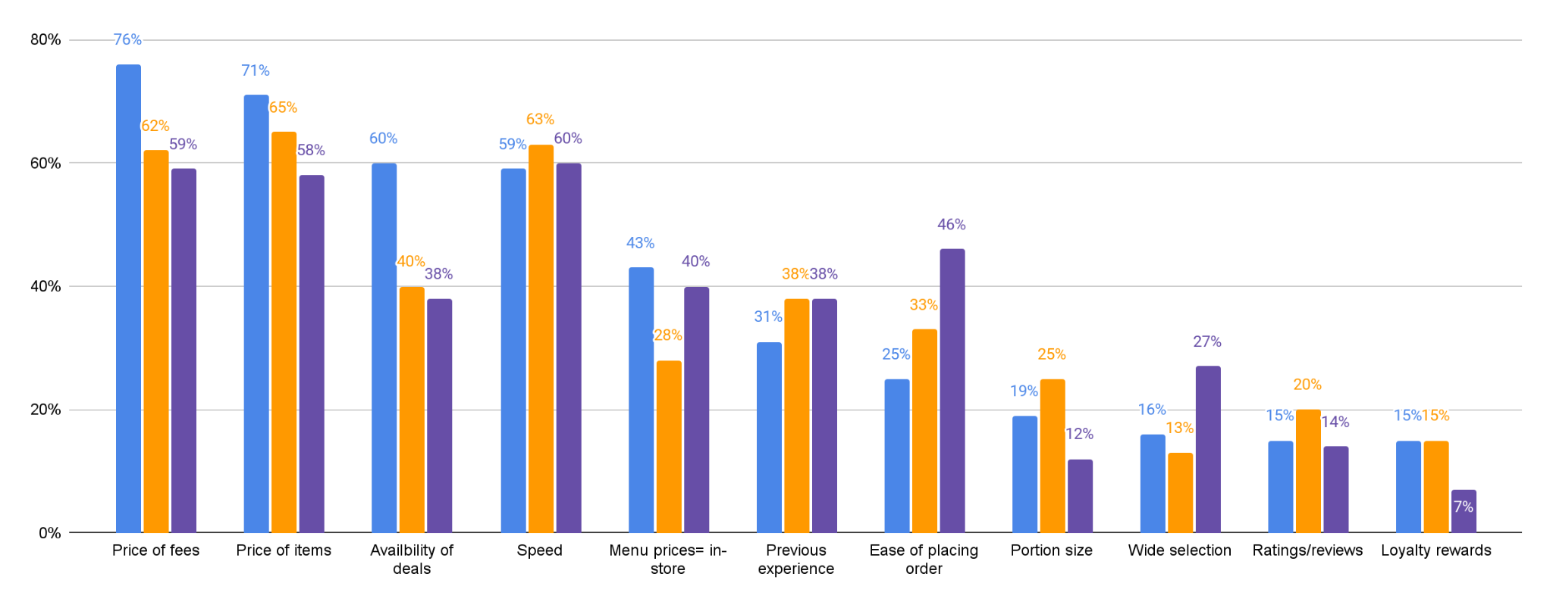
Speed, ease of placing order & selection are all important to TS
Most important factors when selecting where to order
Deal Hunters
Budget Minders
Thrill Seekers
Base: n= 126 Deal Hunters, n=60 Budget Minders, N=85 Thrill Seekers

Slide 24
BM and TS put a greater importance on food timeliness quality and convenience while DH focus more heavily on the deal.
 | Deal Hunters | Budget Minders | Thrill Seekers
Promos are a must:
I will not place an order on any app unless there is a promotion or discount code I can use | 54% | 7% | 2%
I feel guilty when I place an order without a promotion because of the extra costs for delivery | 90% | 12% | 41%
I like to shop around for the best deal and that includes when ordering takeout | 94% | 15% | 64%
Deal seeking is emotional:
I generally am not price sensitive, but like the feeling of getting a good deal | 31% | 17% | 79%
I enjoy the thrill of finding a good deal | 91% | 33% | 75%
Deals are not the #1 priority:
The convenience of ordering on DoorDash is more important than the amount that I spend | 11% | 27% | 52%
I care more about food prices and fees than about getting promotions and discounts | 51% | 53% | 62%
I care more about speed and food quality than promotions when placing an order on DoorDash | 29% | 40% | 55%
Base: n= 126 Deal Hunters, n=60 Budget Minders, N=85 Thrill Seekers

Slide 25
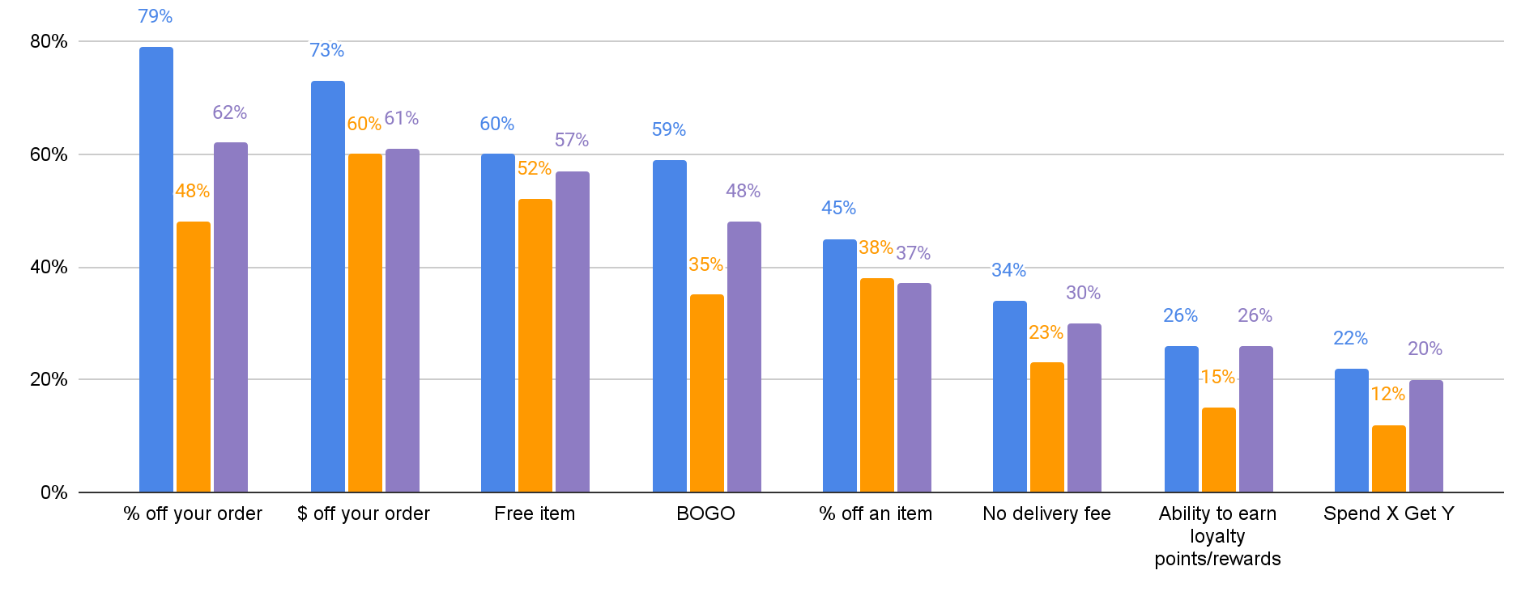
DH have a strong preference for % off; BM and TS prefer a mix of % off, $ off and free items. BM are not a fan of BOGO.
Preferred promotion type by cluster
Deal Hunters
Budget Minders
Thrill Seekers
Base: n= 126 Deal Hunters, n=60 Budget Minders, N=85 Thrill Seekers

Slide 26


All clusters find a minimum of $10 as valuable, but DH expect to spend the least to get that amount
Max amount of spend that feels fair to get a discount:
Min discount amount that feels valuable:
Deal Hunters
$25.66
Deal Hunters
$9.77
Budget Minders
$35.52
Budget Minders
$13.50
Thrill Seekers
$31.56
Thrill Seekers
$10.80
Base: n= 126 Deal Hunters, n=60 Budget Minders, N=85 Thrill Seekers

Slide 27
In their own words…
Deal Hunters
Budget Minders
Thrill Seekers
“Sometimes I'll take a look and there's like a restaurant that I typically would go to and it's right down the street here. It's like something will cost $12 when I go in there, but then on the app, it's like $16. So I typically, I'm like, okay, I'm not gonna go to where I usually would go to because that's just outrageous. I'll probably look at a similar restaurant that has like a price that's a little bit less than that.”
“Like, I think right now, so I'm at this restaurant called Guadalajara and there's like a red bar at the bottom. It's like spend ten dollars. So that will kind of like usually help prompt me a little bit. It says spend ten dollars, get 50 percent off, update dollars. So like that'll kind of prompt me a little bit, but it typically is not until I get to like the final checkout page that I'm looking at.”
“I guess something like food, I mean, cost, yes, matters, but it is not the deciding factor. The deciding factor is going to be what do I feel like having and what's available.”
“I guess something like food, I mean, cost, yes, matters, but it is not the deciding factor. The deciding factor is going to be what do I feel like having and what's available.”
“I guess in my mind, I think about the increased price is attributed to delivery. If they're knocking delivery out, I'm saving a bunch. It may not necessarily make sense, because again, they might add it into the food price or elsewhere, but in my mind, I equate zero delivery fee to a cheaper option. Seeing that zero delivery fee at the bottom is powerful, even if it's a psychological trick in some ways.”
“I'll add stuff to the cart and then see how much it costs. And then if I'm kind of like, oh, I don't know, I'll kind of like go to a different place and see what that's like.”
“What I've noticed with the two for one is like, it literally has to be that exact item, not an item of a like kind. So you're kind of, it's like if you don't like that particular item or if you do, and then the second person doesn't like it, then it doesn't really work that well.”
“The only apps that I usually compare are honestly DoorDash and Uber Eats. And then if I am craving, for example, a burger, then I'll just look at the different burger option that they do have and then see if there's any difference in the fees. Sometimes they do say you save $30 if you spent $20. So if I can see if anybody else is going to want something, then maybe Jack in the Box will be a better option. And that's how I typically do anything with ordering.”
“Some of the local non-chain restaurants offer options where you're ordering like a family meal, right, like a larger family meal, a larger meal consisting of like a variety of different options. So when that happens, I'm not opposed to even spending more if the result is that the amount of food that we're getting delivered, you know is not only enough for dinner, but that there's deliberately some leftovers”
Usually it's gonna be something like one of the 20-25% off deals. Things like that. I'm like oh wow you know that really is a great deal. I'm gonna look into this a little bit more.

Slide 28
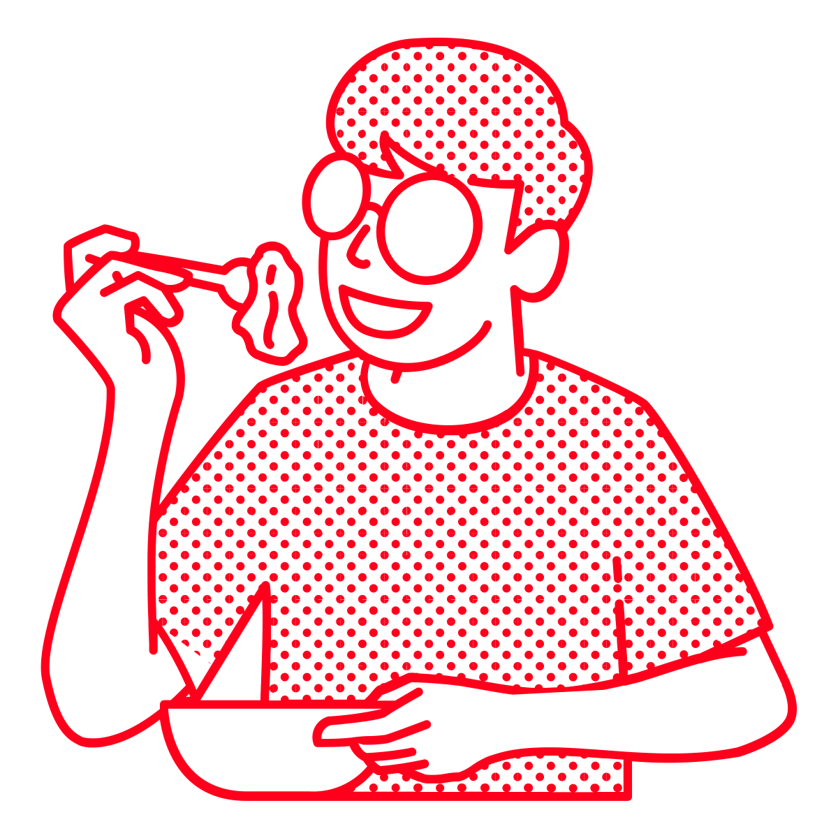
DH are more likely to be ordering for a single individual HH while BM and TS are ordering for 2+ individuals
Typically order “just for me” (single individual orders):
40%
27%
27%
Deal Hunters
Budget Minders
Thrill Seekers
Base: n= 126 Deal Hunters, n=60 Budget Minders, N=85 Thrill Seekers

Slide 29
DH are younger in cities, BM are skew single and TS skew the oldest and in more town or rural communities.
 | Deal Hunters | Budget Minders | Thrill Seekers
Age:
18 to 34 | 47% | 33% | 40%
35 to 49 | 36% | 42% | 26%
50+ | 10% | 18% | 24%
Marital Status:
Married/Partnered | 43% | 35% | 44%
Single | 39% | 47% | 37%
Divorced | 8% | 7% | 6%
Education:
High school diploma or GED | 16% | 23% | 17%
Some college, but no degree or associate's degree | 25% | 31% | 30%
Bachelor’s degree + | 52% | 45% | 44%
Area:
Major metropolitan city | 20% | 13% | 13%
City | 33% | 28% | 26%
Suburb | 29% | 37% | 34%
Town | 8% | 12% | 14%
Rural area/ Countryside | 2% | 3% | 6%
Base: n= 126 Deal Hunters, n=60 Budget Minders, N=85 Thrill Seekers

Slide 30
Next steps

Slide 31
Research to create a draft screener that can be used to identify Cx by persona for future research
Research to share Cx ids from each persona with analytics for deeper behavioral analysis

Slide 32
Thank you!

